Slide 1
What is Service Level Agreement?
A formal contract between a service Provider (SP) and Service Consumer (SC)
SLA: foundation of the consumers trust in the provider
Purpose: To define a formal basis for performance and availability the SP guarantees to deliver
SLA contains Service Level Objectives(SLOs)
Objectively measurable conditions for the service .
SLA and SLO: basis of selection of cloud provider.

Slide 2
Service Level Agreement (SLA)
A Service Level Agreement (SLA) is the bond for performance negotiated between the cloud services provider and the client. Earlier, in cloud computing all Service Level Agreements were negotiated between a client and the service consumer. Nowadays, with the initiation of large utility-like cloud computing providers, most Service Level Agreements are standardized until a client becomes a large consumer of cloud services. Service level agreements are also defined at different levels which are mentioned below:
Customer-based SLA
Service-based SLA
Multilevel SLA

Slide 3
Service Level Agreements usually specify some parameters which are mentioned below:
Availability of the Service (uptime)
Latency or the response time
Service components reliability
Each party accountability
Warranties

Slide 4
Problem 1
Cloud SLA: Suppose a cloud guarantees service availability for 99% of time . Let a third party application runs in the cloud for 12 hours/day. At the end of one month, it was found that total outage is 10.75 hrs.
Find out whether the provider has violated the initial availability guarantee.

Slide 5
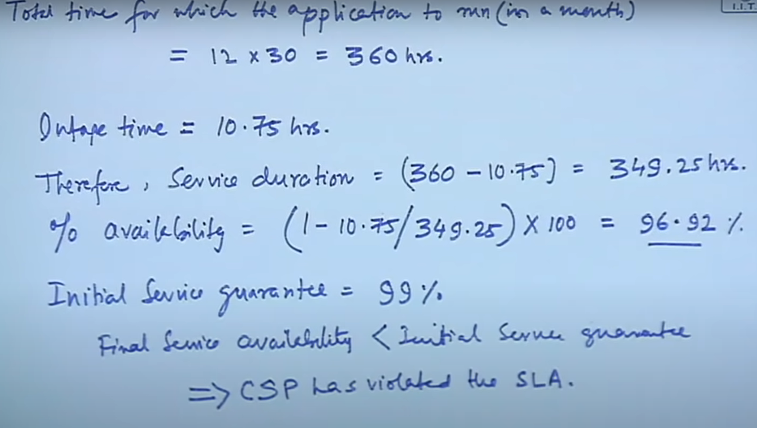

Slide 6
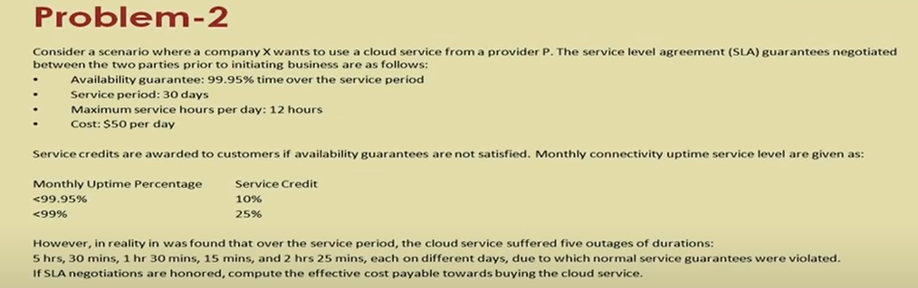
Problem 2

Slide 7
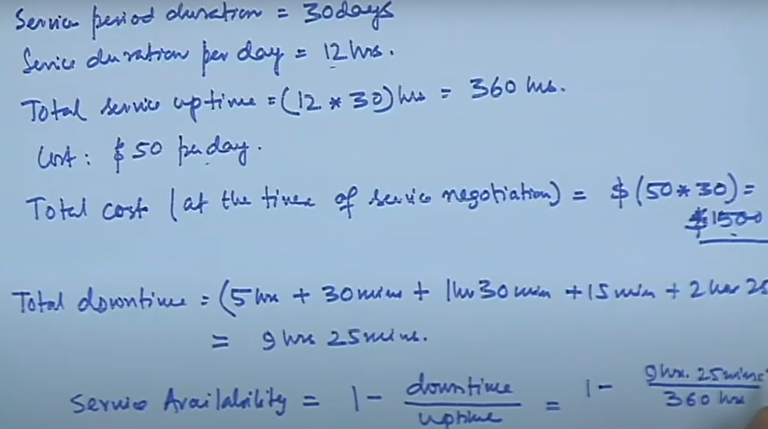

Slide 8
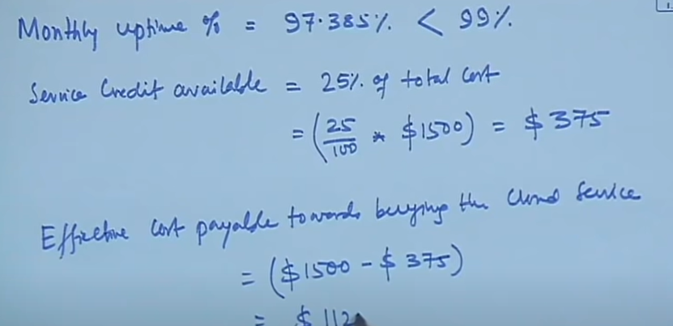

Slide 9
SLA for Cloud Services
Definitions :
1. Applicable Monthly Period : For a calendar month in which a service Credit owed, the number of days that you are a subscriber for Service.
2.Applicable Monthly Service Fees : The total fees actually paid by you for a service that are applied to the month in which a Service Credit is owed.
3.Down time : It is defined for each Service in the Service Specific Tems below.
4.Error Code : means an indication that an operation has failed, such as an HTTP status code in the 5 XX range
External Connectivity is a bidirectional network traffic over supported protocols such as HTTP and HTTPs that can be sent and received from a public IP address.
Incident means i) Any single event or any set of events that result in downtime

Slide 10
SLA for Cloud Services
Management Portal means the web interface, provided by Microsoft . Through which customers may manage the Service.
Service Credit is the percentage of the Applicable Monthly Service fees credited to you following Microsoft s claim approval.
Service Level means the performance metric(s) set forth in this SLA that Microsoft agrees to meet in the delivery of the service
Success Code means an indication that an operation has succeeded such as an HTTP status code in 2XX range.
Support Window refers to the period of time during which a Service feature or compatibility with a separate product or service supported

Slide 11
Additional Definitions
Availability Set
Cloud Services
Fault Domain
Update Domain
Virtual Machine

Slide 12
Monthly uptime Calculation

Slide 13
SLA best practices
The cloud Standard Custom Council provided consumer with the seven steps they should take when evaluating cloud SLAs
Identify the cloud actors
as per NIST reference architecture
Cloud Consumer
Cloud Provider
Cloud carrier
Cloud Broker
Cloud Auditor

Slide 14
SLA best practices
Evaluate business level policies
Data policy, SLA guarantees, list of services not covered, excess usage, payment and penalty methods, subcontracted services, licenced software and industry specific standards
Understand SaaS, PaaS and IaaS
To understand what SaaS , PaaS and IaaS are about and which type of cloud it is running on ( private public or hybrid)
Terms and conditions in the SLA depends on the complexity of control variables that the provider gives to the consumers

Slide 15
Control Parameters
Metrics: To identify what metric should be used to achieve performance objectives. Some examples of availability and response time metric are
Metric name in SLA
Constraints
Methods and frequency of Collection

Slide 16
Security : Considers key security requirements for cloud SLAs including
Assets sensitivity
Legal/regulatory requirements
Cloud Providers security capabilities .

Slide 17
Identify service management requirements
What should be monitored and reported ( for example load performance, application performance ) and what should be metered
How rapid provisioning should be ( speed, testing, demand, flexibility) and how resource change should be managed.

Slide 18
Prepare for and manage service failure
Determine what remedies should be provided (for example, service credits) and what are the liability limitations.
How the disaster recovery plan will work.
An exit clause should be part of every cloud SLA in case either the consumer or provider wants to terminate the relationship

Slide 19
SLA MANAGEMENT IN CLOUD COMPUTING:
A SERVICE PROVIDER’S PERSPECTIVE TRADITIONAL APPROACHES TO SLO MANAGEMENT Traditionally, load balancing techniques and admission control mechanisms have been used to provide guaranteed quality of service (QoS) for hosted web applications. These mechanisms can be viewed as the first attempt towards managing the SLOs. In the following subsections we discuss the existing approaches for load balancing and admission control for ensuring QoS.

Slide 20
TYPES OF SLA :Service-level agreement provides a framework within which both seller and buyer of a service can pursue a profitable service business relationship. It outlines the broad understanding between the service provider and the service consumer for conducting business and forms the basis for maintaining a mutually beneficial relationship. From a legal perspective, the necessary terms and conditions that bind the service provider to provide services continually to the service consumer are formally defined in SLA.
SLA can be modeled using web service-level agreement (WSLA) language specification .Although WSLA is intended for web-service-based applications, it is equally applicable for hosting of applications. Service-level para- meter, metric, function, measurement directive, service-level objective, and penalty are some of the important components of WSLA

Slide 21
Key Components of a Service-Level Agreement
1. Service Level Parameter : Describes an observable property of a service whose value is measurable.
2. Metrics : These are definitions of values of service properties that are measured from a service-providing system or computed from other metrics and constants. Metrics are the key instrument to describe exactly what SLA parameters mean by specifying how to measure or compute the parameter values.
3. Function : A function specifies how to compute a metric‘s value from the values of other metrics and constants. Functions are central to describing exactly how SLA parameters are computed from resource metrics.
4. Measurement directives: These specify how to measure a metric

Slide 22
There are two types of SLAs from the perspective of application hosting
1. Infrastructure SLA : The infrastructure provider manages and offers guaran- tees on availability of the infrastructure, namely, server machine, power, network connectivity, and so on. Enterprises manage themselves, their applications that are deployed on these server machines. The machines are leased to the customers and are isolated from machines of other customers. In such dedicated hosting environments, a practical example of service-level guarantees offered by infrastructure providers.
2.Application SLA: In the application co-location hosting model, the server capacity is available to the applications based solely on their resource demands. Hence, the service providers are flexible in allocating and de-allocating computing resources among the co-located applications. Therefore, the service

Slide 23
LIFE CYCLE OF SLA
Each SLA goes through a sequence of steps starting from identification of terms and conditions, activation and monitoring of the stated terms and conditions, and eventual termination of contract once the hosting relationship ceases to exist.
Such a sequence of steps is called SLA life cycle and consists of the following five phases:
1. Contract definition
2. Publishing and discovery
3. Negotiation
4. Operationalization
5. De-commissioning

Slide 24
1.Contract Definition & Publication and Discovery
1.Contract Definition: Generally, service providers define a set of service offerings and corresponding SLAs using standard templates. These service offerings form a catalog. Individual SLAs for enterprises can be derived by customizing these base SLA templates.
2.Publication and Discovery: Service provider advertises these base service offerings through standard publication media, and the customers should be able to locate the service provider by searching the catalog. The customers can search different competitive offerings and shortlist a few that fulfill their requirements for further negotiation

Slide 25
3. Negotiation:
Once the customer has discovered a service provider who can meet their application hosting need, the SLA terms and conditions needs to be mutually agreed upon before signing the agreement for hosting the application.
For a standard packaged application which is offered as service, this phase could be automated. For customized applications that are hosted on cloud platforms, this phase is manual.
The service provider needs to analyze the application‘s behavior with respect to scalability and performance before agreeing on the specification of SLA.
At the end of this phase, the SLA is mutually agreed by both customer and provider and is eventually signed off.

Slide 26
4.Operationalization
SLA operation consists of SLA monitoring, SLA accounting, and SLA enforcement.
SLA monitoring involves measuring parameter values and calculating the metrics defined as a part of SLA and determining the deviations.
On identifying the deviations, the concerned parties are notified. SLA accounting involves capturing and archiving the SLA adherence for compliance.
As part of accounting, the application‘s actual performance and the performance guaranteed as a part of SLA is reported.

Slide 27
5.De-commissioning.
SLA decommissioning involves termination of all activities performed under a particular SLA when the hosting relationship between the service provider and the service consumer has ended.
SLA specifies the terms and conditions of contract termination and specifies situations under which the relationship between a service provider and a service consumer can be considered to be legally ended.

Slide 28
SLA MANAGEMENT IN CLOUD
SLA management of applications hosted on cloud platforms involves five phases.
1. Feasibility
2. On-boarding
3. Pre-production
4. Production
5. Termination

